Slide 1
Biomarkers of Breast Cancer
Predicting of Breast Cancer
Author: Pooja Vasudevan
Intro to Data Science

Slide 2
Overview
Breast Cancer most common disease among women
Important linkage between diabetes and cancer patients
Important Contributing Factors:
Insulin, Glucose, BMI, HOMA
Adiponectin, Resistin, Leptin

Slide 3
Insulin, Glucose, and HOMA
High levels of insulin facilitates cancer growth
HOMA index measures insulin resistance
Exercise, healthy weight, and limited use of alcohol helps to maintain blood sugar levels

Slide 4
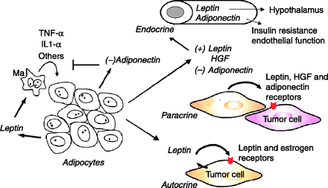
Resistin, Adiponectin, and Leptin
Obesity reflected by BMI
Adipokines mediate obesity
Adipokines may be a major link between obesity and breast cancer progression

Slide 5
Data Set
The data was collected from UCI Machine Learning in Center for Machine Learning Repository
Data obtained by observing and measuring clinical features of 64 patients
10 quantitative predictors and binary dependent variable
Quantitative Attributes
Age (years)
BMI (kg/m2)
Glucose (mg/dL)
Insulin (µU/mL)
HOMA
Leptin (ng/mL)
Adiponectin (µg/mL)
Resistin (ng/mL)
MCP-1(pg/dL)

Slide 6
Regression Analysis
Logistic regression model was generated to evaluate the quantitative attributes against the binary dependent value
Binary dependent variable: 1- presence of breast cancer, 0 – absence of breast cancer
Insulin has the highest probabilistic (20%) increase of cancer for every unit of increase
 | Estimate | Std. Error | z value | Pr(>|z|)
(Intercept) | -5.438684 | 3.338638 | -1.629 | 0.10331
Age | -0.022373 | 0.015563 | -1.438 | 0.15055
BMI | -0.132158 | 0.063186 | -2.092 | 0.03648
Glucose | 0.101003 | 0.033868 | 2.982 | 0.00286
HOMA | -0.568062 | 1.067928 | -0.532 | 0.59478
Insulin | 0.203698 | 0.257784 | 0.790 | 0.42942
Leptin | -0.013537 | 0.016748 | -0.808 | 0.41893
Adiponectin | -0.005895 | 0.037323 | -0.158 | 0.87451
Resistin | 0.065705 | 0.030615 | 2.146 | 0.03186

Slide 7
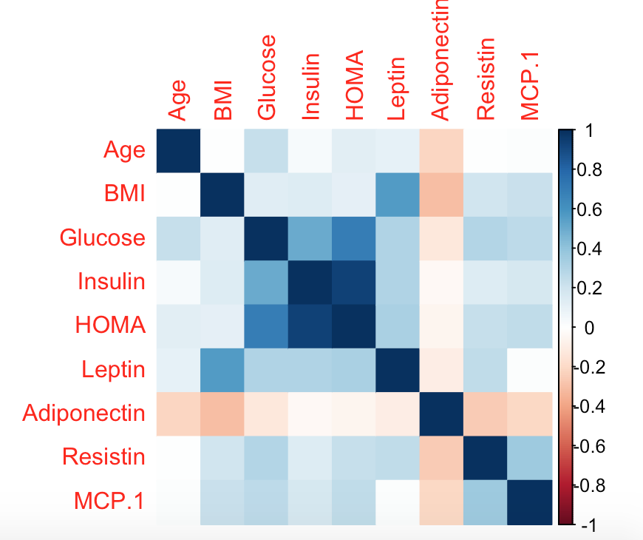
Color Plot
Depicts variables with strongest and least correlation
Strongest – Insulin and HOMA
Weaker – HOMA and Adiponectin

Slide 8
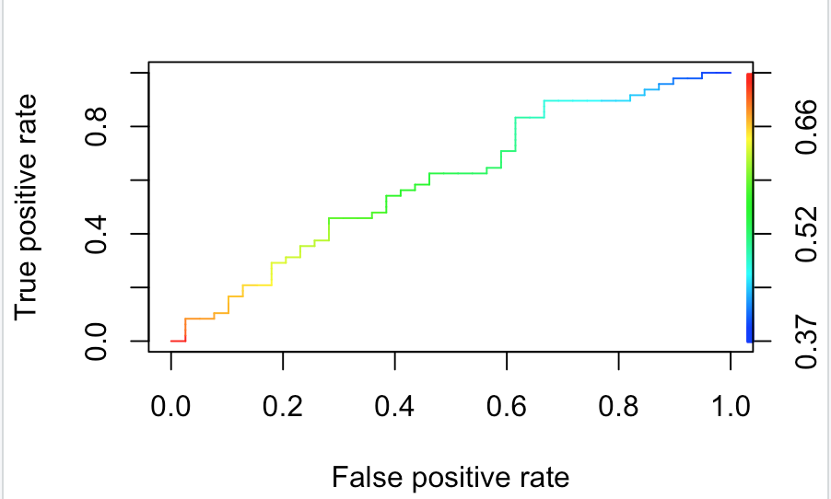
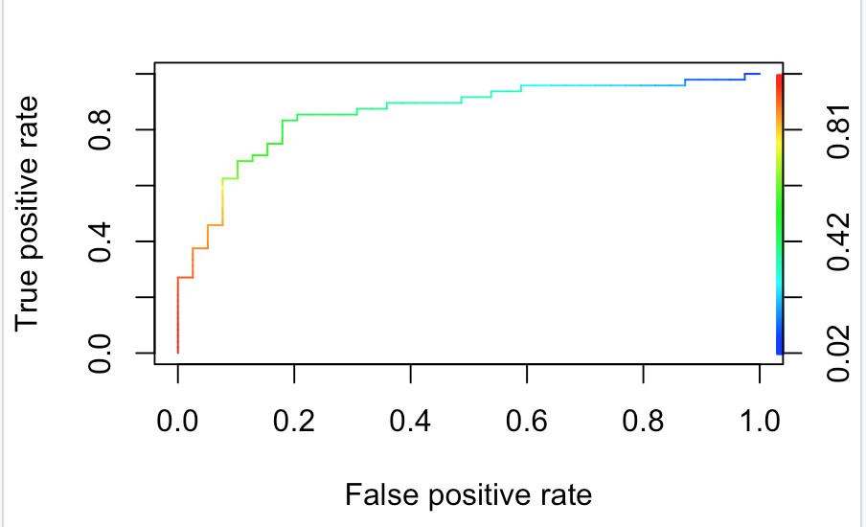
Confusion Matrix - ROC
 | Predictor(P) | Predictor (N)
Actual (P) | 28 (TP) | 11 (FN)
Actual (N) | 28 (FP) | 20 (TN)
 | Predictor(P) | Predictor (N)
Actual (P) | 35 (TP) | 4 (FN)
Actual (N) | 17 (FP) | 31 (TN)
Training Data
Test Data

Slide 9
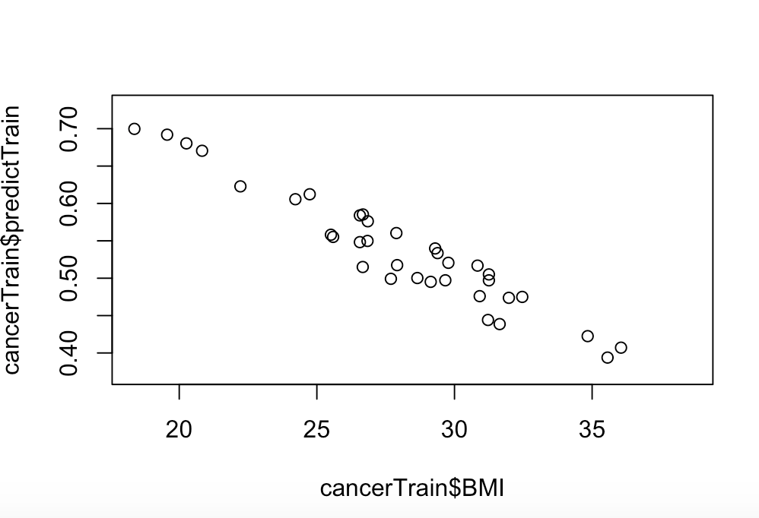
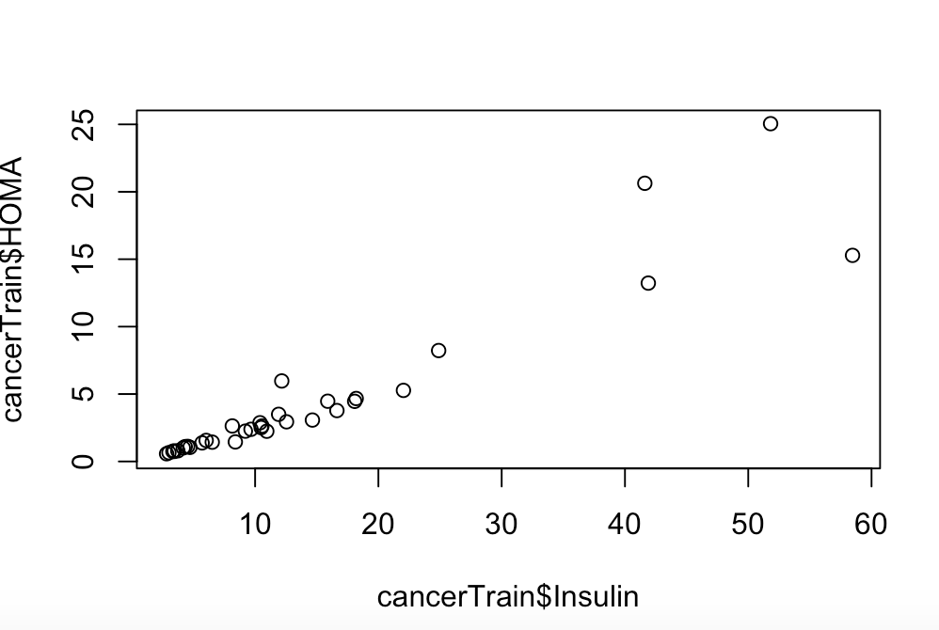
Scatter Plots

Slide 10
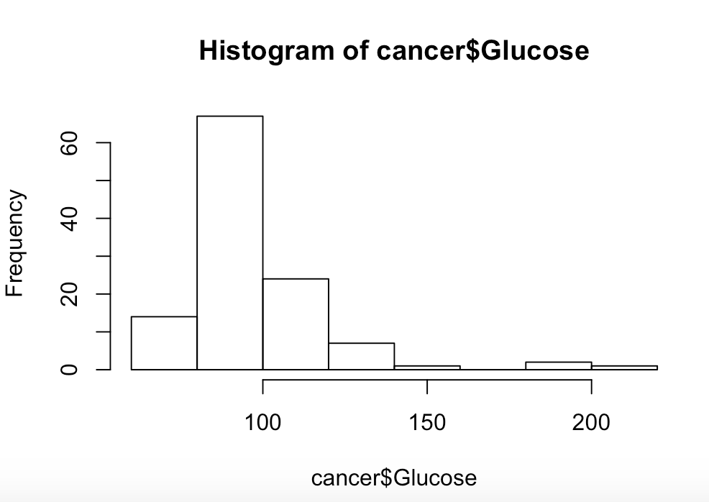
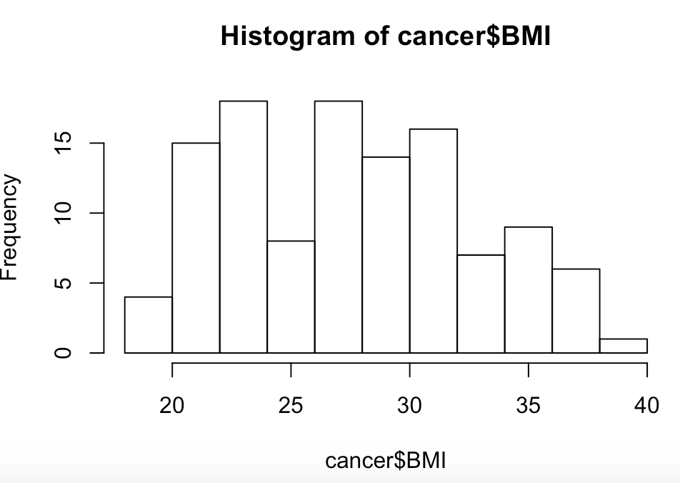
Histograms

Slide 11
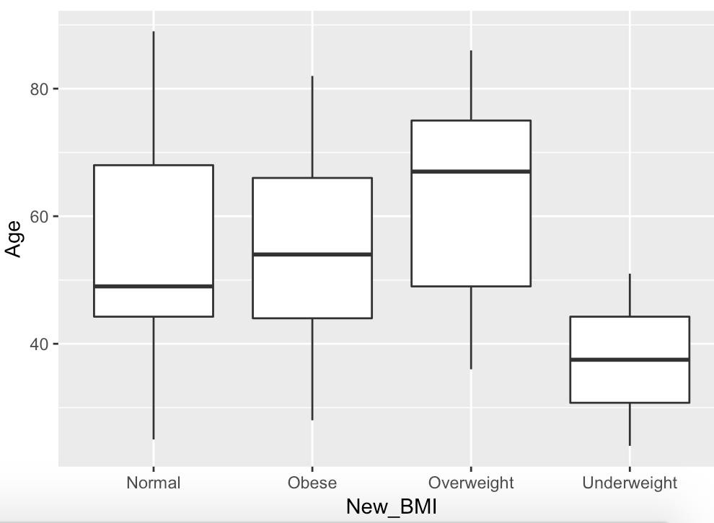
Plots
BMI categories : Underweight (less than 19 kg/m2), Normal (19-25 kg/m2), Overweight (25-30 kg/m2), and Obese (over 30 kg/m2).
Age well distributed normal BMI
Senior citizens tend to have a higher BMI

Slide 12
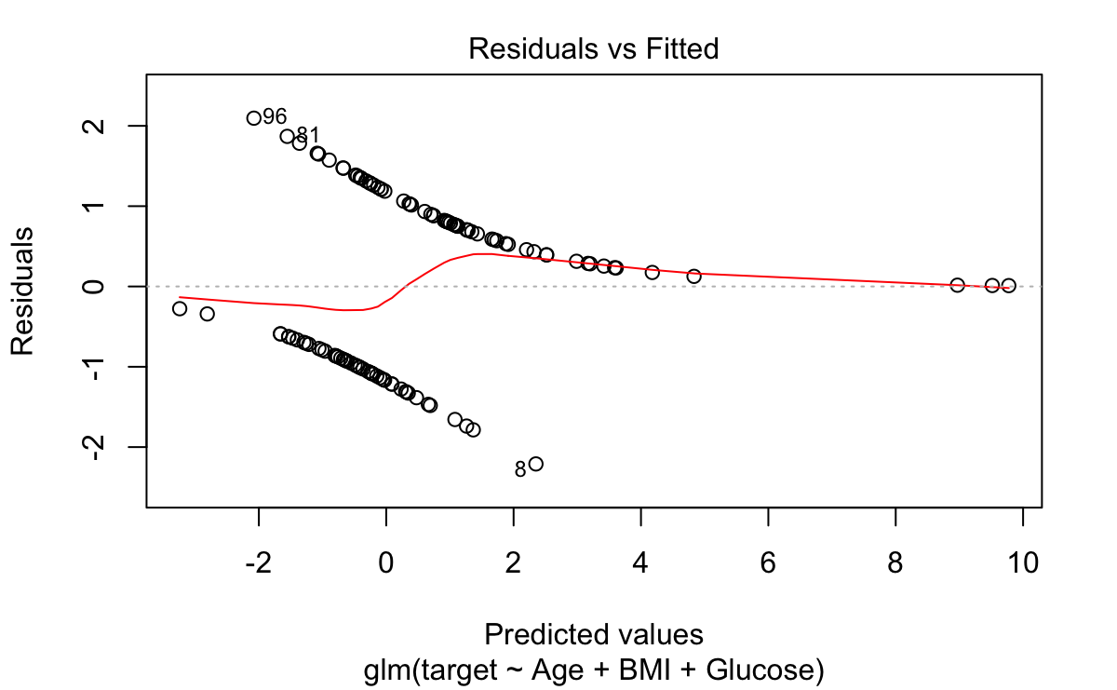
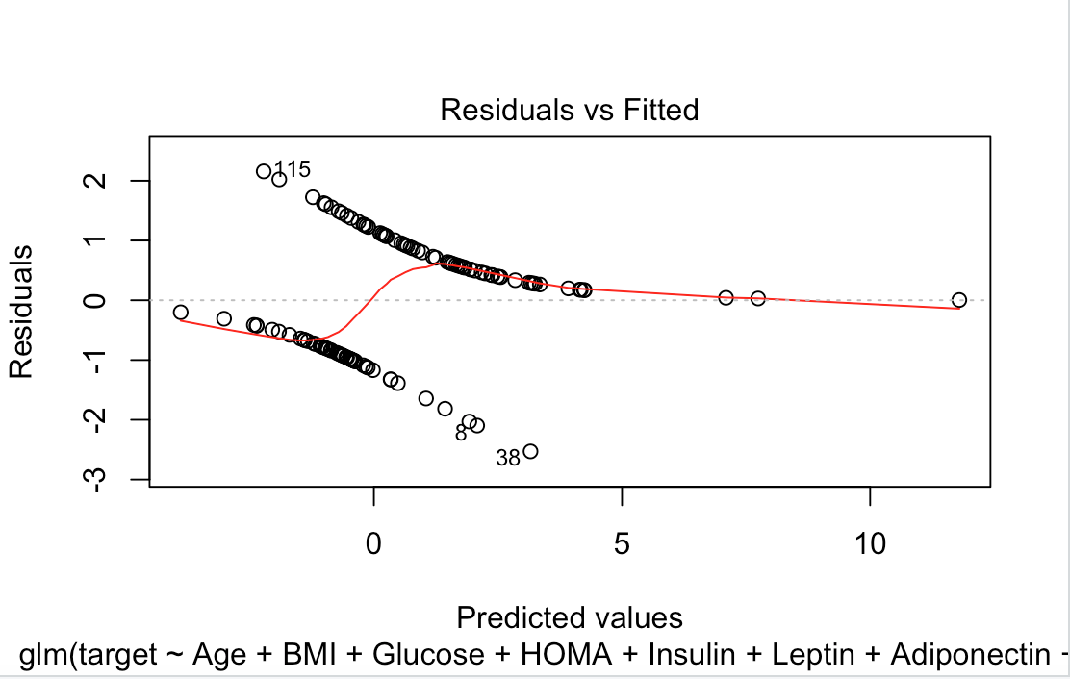
Residuals

Slide 13
Results and Discussion
Insulin seems to be the most significant factor in contributing to the presence of breast cancer with 20% increase chance of cancer with every unit increase. Insulin is linked to diabetes and diabetic patients have a higher risk of breast cancer.
Higher BMI levels are characterized in senior citizens who are about 58-65 years old, which poses a higher risk to cancer development
Insulin and HOMA have a positive linear correlation. Thus, patients with high levels of insulin have a higher HOMA index.
Resistin, an important protein contained in adipose tissue, contributes to obesity.

Slide 14
Future Work
Better understanding of chemical and physical properties to understand correlation.
Interactions most relevant

